Slide 1


Final Project Review
Gemline: New Product Forecasting
Company Name: Gemline
Date: 10.23.25
Trinity Briggs | Valeria Karina Marin-Gallo | Nikhil Satpathy | Emmanuel Tchonang

Slide 2
Agenda
Company Name: Gemline
Date: 09.18.2025
Team + Sponsor Intro
Company Background
Situation + Goals
Deliverables
Data Manipulation
Analytical Model Formulation
Findings + Tools
Recommendations
Action Plan
Gantt Chart
Conclusion
References

Slide 3




Team + Sponsor Introductions
Company Name: Gemline
Date: 09.18.2025
Emmanuel Tchonang
IOE Senior Fall 2025
Nikhil Satpathy
IOE Senior Winter 2026
Trinity Briggs
IOE Senior Winter 2026
Valeria Marin-Gallo
IOE Senior Winter 2026
Tim Behling
VP of Supply Chain
Chris Harrison
Manager of Supply Chain
Operations Research
Data Analytics
Data Analytics
Financial Engineering
Math
Sustainable Engineering
Risk Management
Data Analytics
Data Analytics
Lean Manufacturing
7 years 1 month
15 years 5 months

Slide 4



Gemline
Lawrence, Massachusetts
1958
Supplier of Promotional Products
450 Employees
Gemline designs, sources, and supplies high-quality branded promotional products (bags, drinkware, tech, etc.) for the promotional products industry
Gemline succeeds by pairing in-house, trend-driven design and marquee brand partnerships with an integrated global supply chain and B Corp–level social responsibility, delivering reliable quality and service that keep them a top-ranked supplier.
“We have deep experience in design, product engineering, factory oversight and compliance and a long-standing reputation for the highest levels of quality and customer satisfaction”
Notes:
nikhil

Slide 5






Situation
Goals
Gemline has partnered with the University of Michigan to address the industrial engineering challenge of improving new product forecasting and inventory optimization in the face of high product variety and limited historical data.
Predict new product performance with 80% accuracy
Estimate cannibalization of existing product
Increase fill rates and reduce stockouts
Achieve above goals while utilizing Operations Research & Analysis and Information Engineering knowledge sectors
Notes:
nikhil

Slide 6
Vent Will Provide Gemline With Two Key Deliverables Related to Project Goals
Market Entry Tool
Predictive Model
1
2
Utilizes historical sales data to quantify the correlation between product launch timing and sales performance
Filtered by product attribute
Correlation tables & visualization plots
New product performance
1st year of lifecycle
Forecast based off of products with similar attributes that do have historical data
Aiming to have ~20% MAPE
Estimate of cannibalization effects
Notes:
nikhil

Slide 7

The Project Encompasses Three Main Focal Points
Optimal Market Entry
Historical Sales Data
Predicted Demand
Product Attributes
Categories at risk of cannibalization
‹#›
Notes:
Trinity

Slide 8




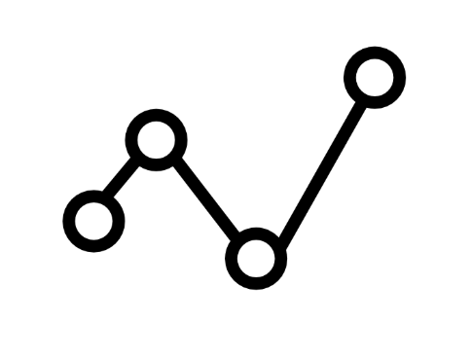
Gemline Gave us Four Areas to Disregard
Use of Advertising
Niche Product Lines
Discounts or Promotions
Predictions > 1 year
‹#›
Notes:
Trinity

Slide 9
The Interactive Model will Forecast Product Performance with 80% Accuracy
1
2
3
4
Highlight Patterns Within Data
Anticipate Demand of Products
Optimize Restock Times
Prevent Likelihood of Stockouts
Predict Likeliness of Cannibalization
Notes:
Trinity

Slide 10
Data Manipulation
Steps | Description | Output/Validation
Load + Prepare Date | Imported multi-sheet Excel files from Google Drive; standardized headers, data types, and trimmed spaces | 4 years of sales records merged
Clean + Normalize | Removed blanks, standardized NA values, and filtered out discontinued or irrelevant SKUs (OOC, PPE, PAD) | Logged row counts before/after cleaning + excel sanity checks
Merge + Map | Joined SKU attributes with sales data on Item; mapped Category → Category Name using a custom dictionary. | Verified completeness & reduced unmapped items.
Validate | Checked dropped-row counts by reason, removed invalid ShipDate entries, summarized rows by year. | Final analytics-ready dataset for modeling.

Slide 11
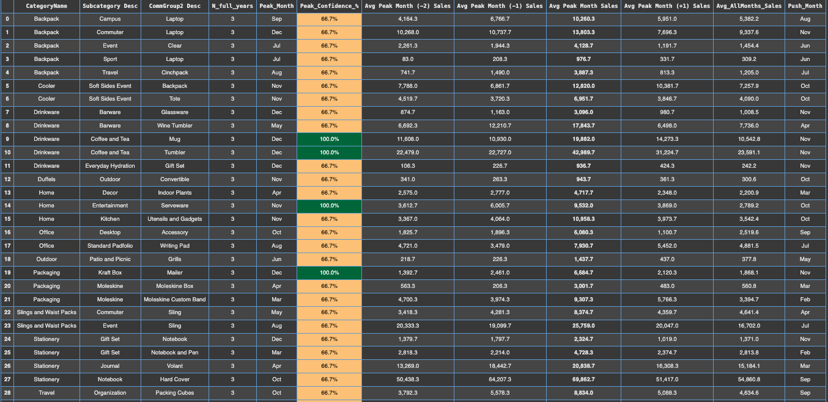
Market Entry Findings P3

Slide 12
Market Entry Recommendations
# of Groupings | Percent Confidence
27 Groupings | 66.6 %
4 Groupings | 100 %
Category | Subcategory Desc | CommGroup2 Desc | Confidence | Peak Month
Drinkware | Coffee and tea | Mug | 100% | December
Drinkware | Coffee and tea | Tumbler | 100% | December
Home | Entertainment | Serveware | 100% | November
Packaging | Kraft Box | Mailer | 100% | December

Slide 13
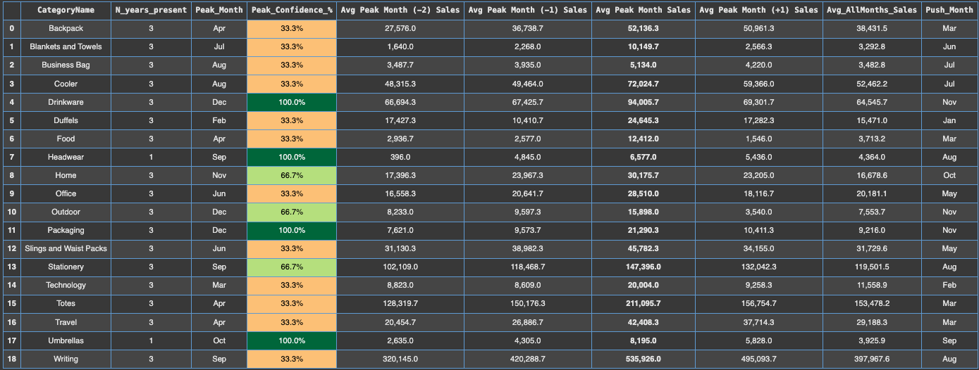
Market Entry Findings (Category)

Slide 14
Market Entry Recommendations (Category)
Category | Confidence | Peak Month
Home | 66% | November
Outdoor | 66% | December
Stationary | 66% | September
# of Groupings | Percent Confidence
3 Groupings | 66.6 %
4 Groupings | 100 %
Category | Confidence | Peak Month
Drinkware | 100% | December
Headwear* | 100% | September
Packaging | 100% | December
Umbrellas* | 100% | October

Slide 15
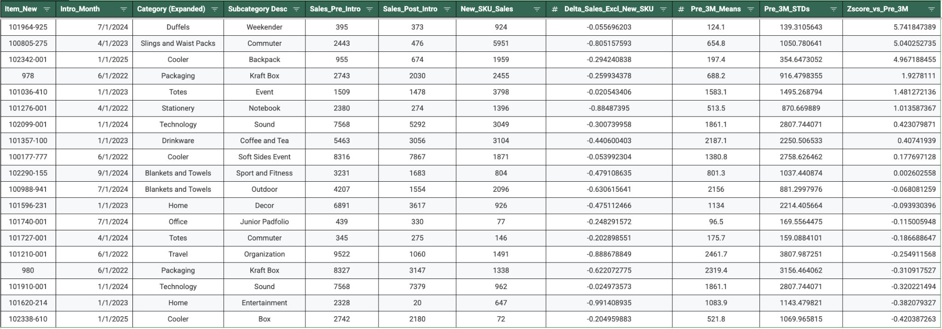
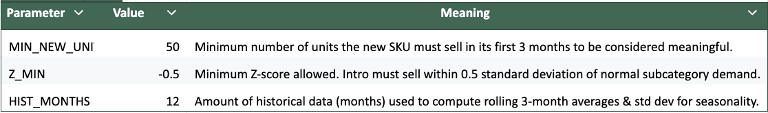
Cannibalization Analysis Part 1

Slide 16
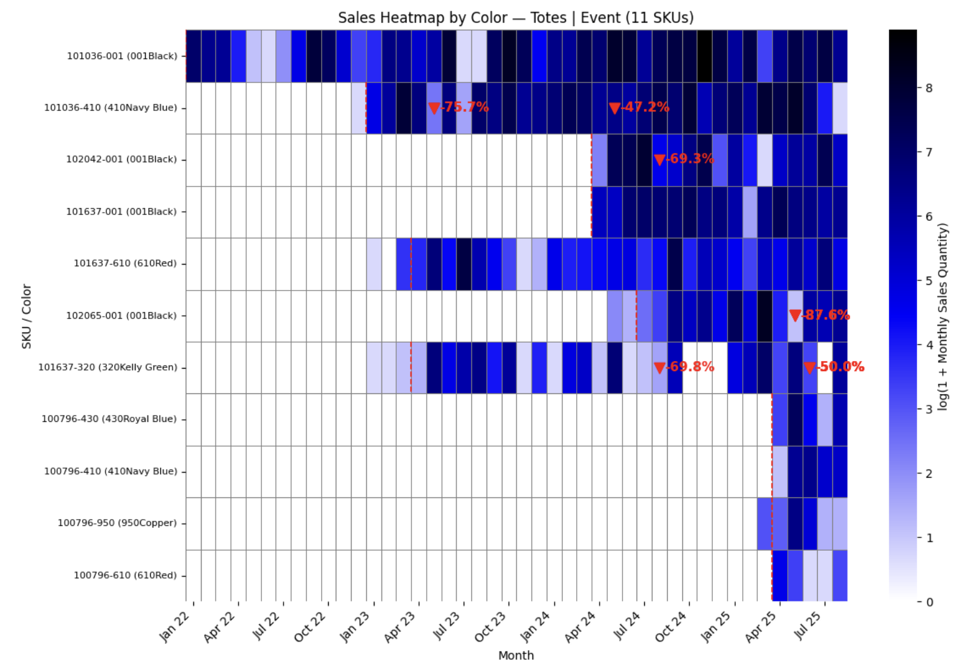
Cannibalization Analysis Part 2
Valeria to add bullets (if needed)

Slide 17
Model Formulation: Tree based models

Slide 18
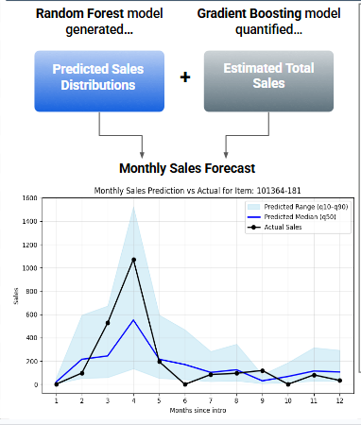
Predicted monthly sales of new products using two tree based models

Slide 19

Used a random forest to predict sales distribution
Features sales distribution was trained on:
Subsubgroup
Intro Month

Slide 20
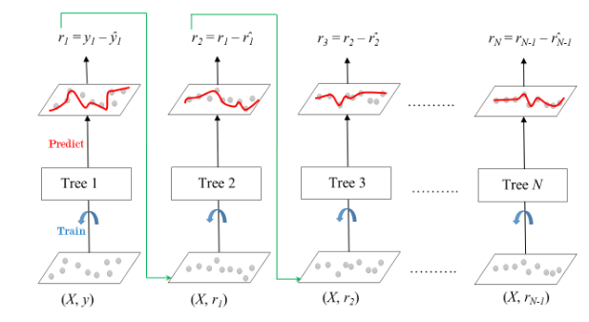
Used a gradient boosting model to predict total sales
Features total sales was trained on:
Subsubgroup
Intro Month
Brand
Price Range

Slide 21
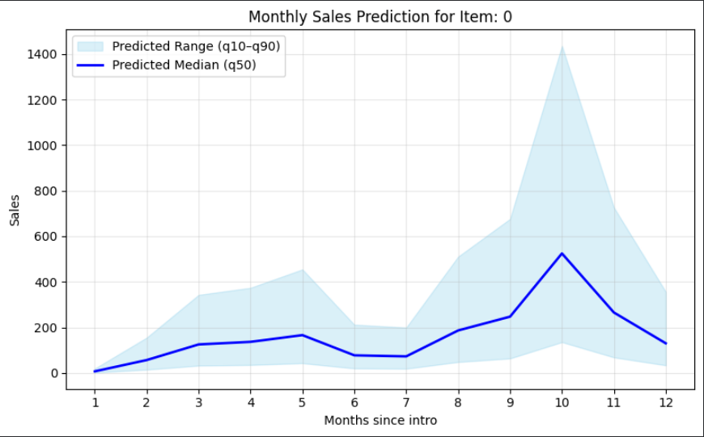
Combined predicted sales distribution along with predicted total sales to get monthly sales forecast

Slide 22




Action Plan Consisted of Three Steps
Data cleaning
Describing past sales
Create predictive models for demand
Data cleaning
Descriptive analytics
Predictive analytics
Prepare Gemlines data set for analytics by determining information relevant to demand forecasting and then identifying any missing data
Visualize sales from past years, to give us a better understanding of Gemline’s current sales trajectory and identify any trends
Create models to predict demand for new products and old products while accounting for and calculating cannibalization
What we will do
Determine relevant attributes in datasets
Identify missing values
Graph past sales
Forecast demand using:
Bayesian networks
Machine learning
Simulation
Key actions

Slide 23
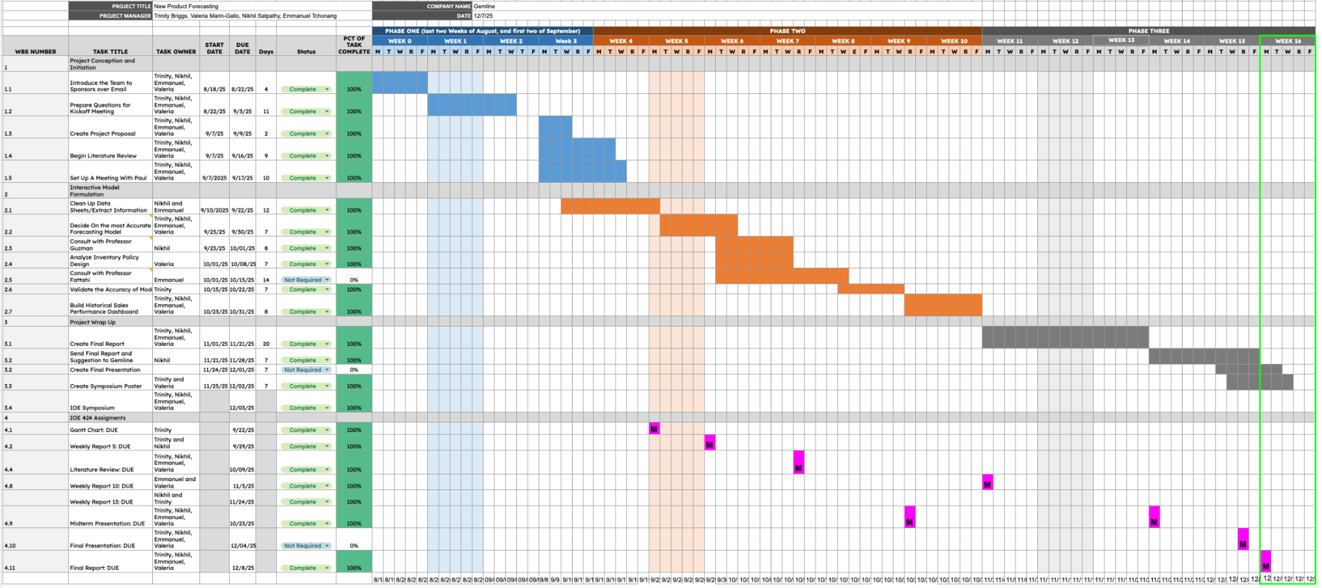
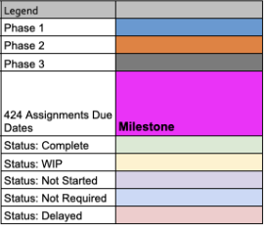
Vent Shared a Timeline with Gemline That Outlines the Whole Project

Slide 24


Gemline Challenged Vent to Forecast Sales with Limited Data and Provide Information to Reduce Cannibalization
Our Solution
Impact
Forecasted 7 subcategories with 75% accuracy and 12 with 65%
91.67%, 83.33%, 75.83%, and 75%
Created interactive forecasting dashboard
Determined market entry with 100% confidence for four groupings and 66.66% for 27 groupings
Estimated year one cost savings of $1-2 million
Reduce excess inventory due to more accurate forecasting
Incremental sales revenue captured by better anticipating upside demand and having inventory available

Slide 25
Thank you for listening!
Any questions or concerns?
‹#›

Slide 26
References
[1] X. Zhang, L. Chen, and Y. Wu, “New product demand forecasting using gradient boosting and clustering with seasonal effects,” Computers & Industrial Engineering, vol. 187, p. 110345, 2024. doi:10.1016/j.cie.2024.110345
[2] Van Steenbergen, R.M., and M.R.K. Mes. “Forecasting demand profiles of New Products.” Decision Support Systems, vol. 139, Dec. 2020, p. 113401, https://doi.org/10.1016/j.dss.2020.113401.
[3] Ching-Chin, Chern, et al. “Designing a decision-support system for new product sales forecasting.” Expert Systems with Applications, vol. 37, no. 2, Mar. 2010, pp. 1654–1665, https://doi.org/10.1016/j.eswa.2009.06.087
[4] M. P. R. Mahin, M. Shahriar, R. R. Das, A. Roy, and A. W. Reza, “Enhancing sustainable supply chain forecasting using machine learning for sales prediction,” Procedia Computer Science, vol. 252, pp. 470–479, 2025, doi: 10.1016/j.procs.2025.01.006.
[5] Kirill Kashtanov, et al. “Using Triple Exponential Smoothing and Autoregressive Models to Mining Equipment Details Sales Forecast.” Communications in Computer and Information Science, 1 Jan. 2022, pp. 506–521, https://doi.org/10.1007/978-3-030-93715-7_36.

